Slide 1

Fast Quantum Byzantine Agreement
Progetto per High Performance Computing
Andrea Adorni, Giovanni Schianchi

Slide 2

Byzantine Agreement
Common decision among all
Presence of cheating peers
Agreement
Validity
Termination

Slide 3

Fast Quantum Byzantine Agreement
Quantum alternative
1 round
Protection against cheaters up to n/3

Slide 4

QOCC
Subroutine when there isn’t an agreement
When sum of bits is beetwen n/3 and 2n/3
Every peer returns a bit with a certain probability
VQSS encoding to defend from malicious peer

Slide 5

QOCC Algorithm
Composed by three subroutines
Every peer sends and receive bits from other
Calculate the sum of bits and checks it
In base to sum sets the bit to 0 or 1

Slide 6

Implementation
NetQASM to make quantum network applications
Python
SquidASM to simulate application

Slide 7
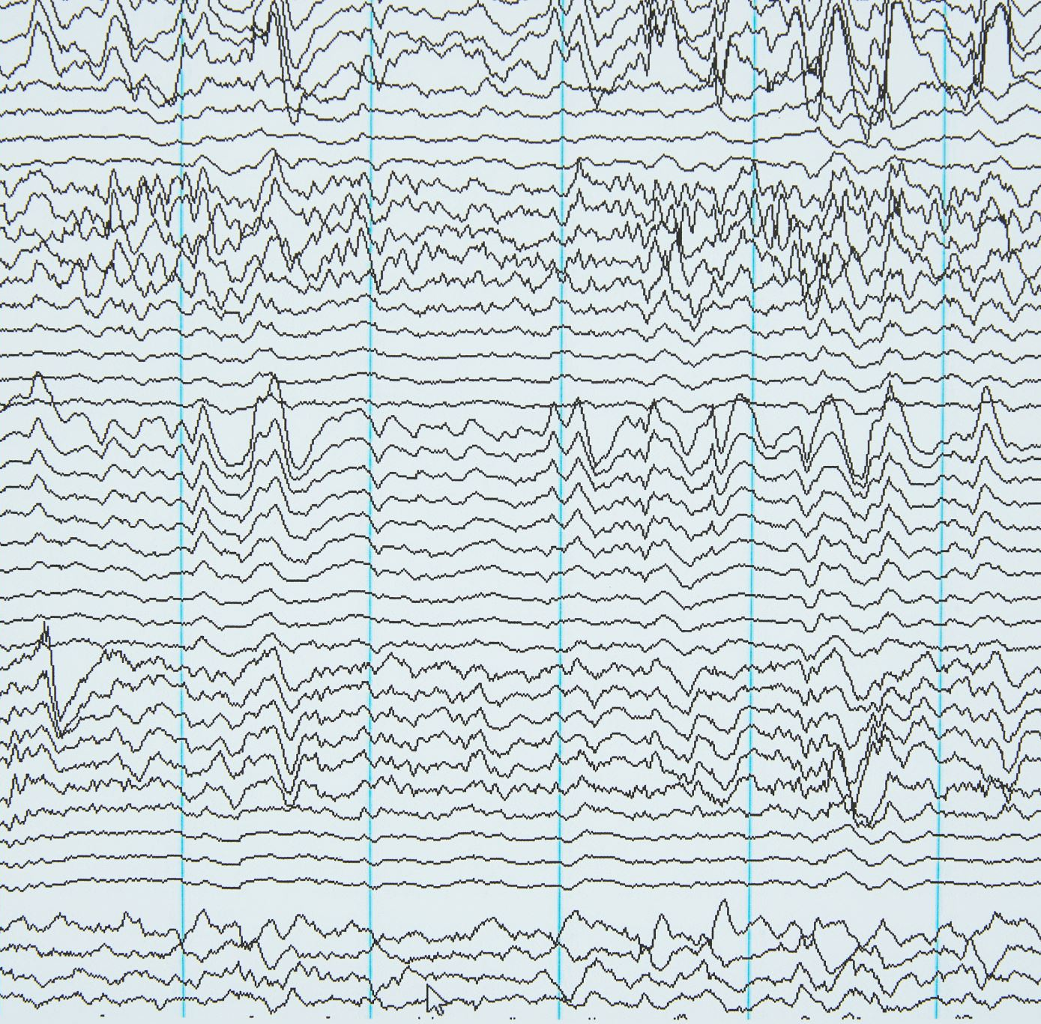
Results Parameters :
Gate fidelity and fidelity
Type noise
Decoherence times
Number of peers

Slide 8
Results

Slide 9

Conclusions
In the ideal case, the number of iterations is equal to 1
More noise more iterations
High number of peers ensure greater robustness to noise

